Slide 1
An Overview of Network Systems
Session 01
Course : COMP6584001 – Network and Systems Programming
Ivan Sebastian Edbert

Slide 2
Learning Objectives
At the end of this session, the student will be expected to :
Understand Network Topology
Understand Bandwidth vs Latency
Understand TCP/IP Model

Slide 3
Outline
Network Topology
Bandwidth vs Latency
TCP/IP Model

Slide 4
Network Topology

Slide 5
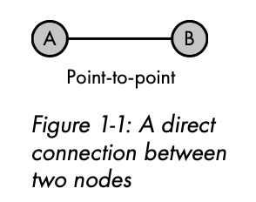
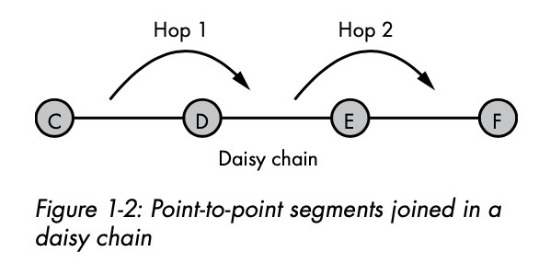
Network topology
Point-to-point
Point-to-point : two nodes share a single connection. This type of network connection is uncommon, though it is useful when direct communication is required between two nodes.
A series of point-to-point connections creates a daisy chain. In the daisy chain in Figure 1-2, traffic from node C, destined for node F, must traverse nodes D and E. Intermediate nodes between an origin node and a destina- tion node are commonly known as hops. You are unlikely to encounter this topology in a modern network.

Slide 6
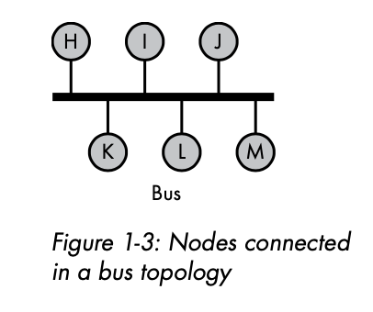
Network topology
Bus topology
Bus Topology nodes shares a common network link
Wired bus networks aren’t common, but this type of topology drives wireless networks.
Nodes on wired network to see all the traffic and selectively ignore or accept it.
Although wireless clients can see each other’s traf- fic, traffic is usually encrypted.

Slide 7
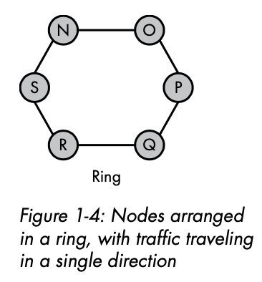
Network topology
Ring topology
Each network device is connected to exactly two other devices, forming a circular or ring-like structure.
In a ring network, data travels in one direction around the ring, passing through each device until it reaches its destination.
A failure in one part of the ring can disrupt the entire network, and the addition of new devices can be more challenging compared to some other topologies.

Slide 8
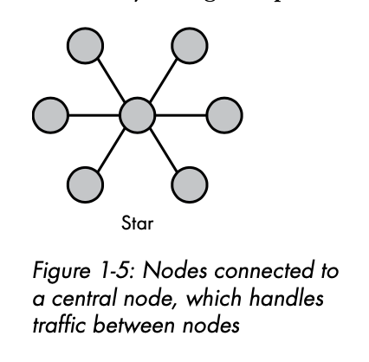
Network topology
star topology
A star topology is a type of network topology in which each device in the network is connected to a central hub or switch
All communication between devices passes through the central hub, where this hub can be an actual physical device or a logical point in a network switch.
This topology has a negative impact when the central hub fails, the entire network can be affected. In some cases, this limitation is addressed by using redundant hubs or switches for increased fault tolerance.

Slide 9
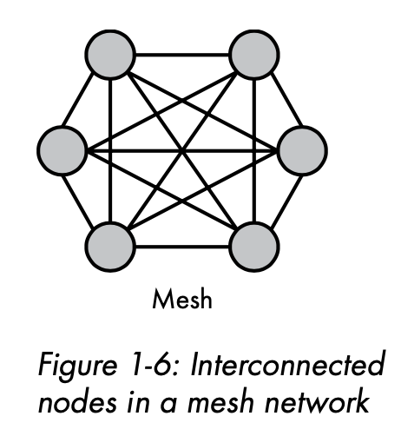
Network topology
Mesh topology
Mesh topology is a type of network topology in which each node (device or computer) is connected to every other node in the network.
In a mesh network, the devices are interconnected to provide multiple paths for data transmission.
This topology eliminates single points of failure because the failure of a single node doesn’t affect traffic between any other nodes on the network.
On the other hand, costs and complexity increase as the number of nodes increases, making this topology untenable for large-scale networks

Slide 10
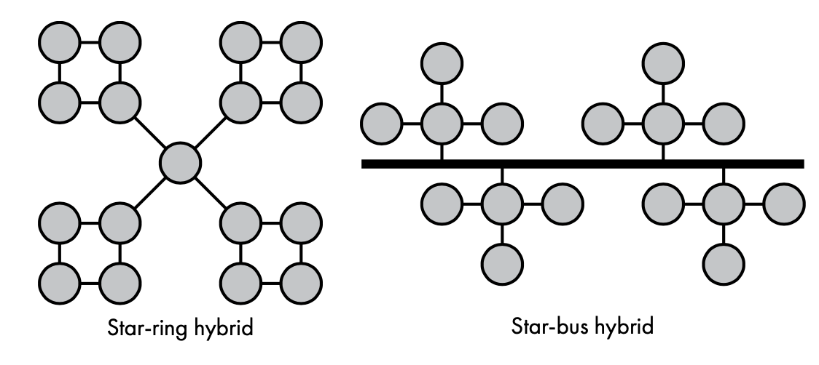
Network topology
Star-ring hybrid & Star-bus hybrid
Hybrid topologies are meant to improve reliability, scalability, and flex- ibility by taking advantage of each topology’s strengths and by limiting the disadvantages of each topology to individual network segments.
Hybrid topologies often combine elements of bus, star, ring, and mesh topologies. The choice of topologies depends on the specific requirements and characteristics of the network.
Example:
    Star-Ring topology
    Star-Bus topology
    Mesh-Tree topology
    Mesh-Star topology

Slide 11
Bandwidth vs latency

Slide 12
Network Bandwidth
Network bandwidth is the amount of data we can send over a network connection in an interval of time.
Bandwidth is a crucial metric in networking and telecommunications as it determines how much information can be transmitted over a network within a specific time frame.
For example, 1 Kbps is equal to 1,000 bits per second, and 1 Mbps is equal to 1 million bits per second.
However, faster doesn’t always mean greater performance. It may seem counterintuitive, but a lower-bandwidth network connection may seem to have better performance than a higher- bandwidth network connection because of one characteristic: latency.

Slide 13
Network Latency
Network latency is a measure of the time that passes between sending a network resource request and receiving a response.
An example of latency is the delay that occurs between clicking a link on a website and the site’s rendering the resulting page.
A website’s latency comes from several sources: the network latency between the client and server:
The time it takes to retrieve data from a data store
The time it takes to compile dynamic content on the server side
The time it takes for the web browser to render the page

Slide 14
Open Systems Interconnection (OSI)

Slide 15
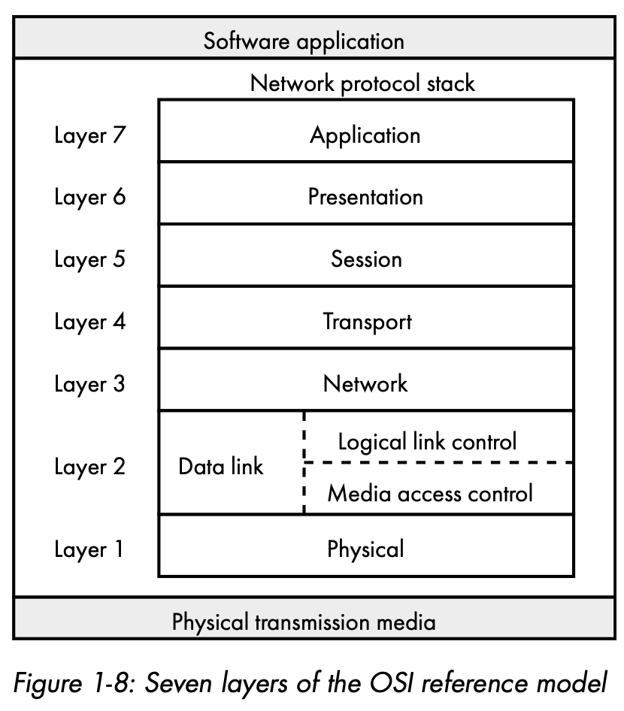
Open Systems Interconnection (OSI)
The Open Systems Interconnection (OSI) model is a conceptual framework that standardizes the functions of a telecommunication or computing system into seven abstraction layers.
The Open Systems Interconnection (OSI) model is a conceptual framework that standardizes the functions of a telecommunication or computing system into seven abstraction layers.
Protocols are rules and procedures that determine the format and order of data sent over a network.
For example, communication using the Transmission Control Protocol (TCP) requires the recipient of a message to reply with an acknowledgment of receipt. Otherwise, TCP may retransmit the message.

Slide 16
TCp/ip model

Slide 17
TCP/IP Model
TCP/IP—named for the Transmission Control Protocol and the Internet Protocol—facilitated networks designed using the end-to-end principle, whereby each network segment includes only enough functionality to properly transmit and route bits
The TCP/IP model consists of four layers, each with its specific set of protocols.
Link Layer (or Network Interface Layer)
Internet Layer
Transport Layer
Application Layer

Slide 18
Tcp/ip model
Link Layer (or Network Interface Layer)
Corresponding to the combination of the OSI model's Physical and Data Link layers, the Link Layer deals with the physical connection to the network and the framing of data into frames.
Protocols associated with this layer include Ethernet, Wi-Fi (802.11), and Point-to-Point Protocol (PPP).

Slide 19
Tcp/ip model
Internet layer
The Internet Layer is equivalent to the OSI model's Network Layer. It is responsible for logical addressing, routing, and the fragmentation and reassembly of packets.
The Internet Protocol (IP) is the primary protocol of this layer, and it provides the addressing and routing functions. Internet Control Message Protocol (ICMP) is also part of this layer, used for network diagnostics and error reporting.

Slide 20
Tcp/ip model
Transport layer
Similar to the OSI model's Transport Layer, the TCP/IP Transport Layer manages end-to-end communication, including error detection and correction, flow control, and segmentation and reassembly of data.
Two main transport layer protocols are Transmission Control Protocol (TCP), which provides reliable, connection-oriented communication, and User Datagram Protocol (UDP), which is a simpler, connectionless protocol often used for real-time applications.

Slide 21
Tcp/ip model
Application layer
The Application Layer corresponds to the combination of the OSI model's Session, Presentation, and Application Layers. It provides network services directly to end-users and application processes.
Various protocols operate at this layer, including Hypertext Transfer Protocol (HTTP) for web communication, File Transfer Protocol (FTP) for file transfers, Simple Mail Transfer Protocol (SMTP) for email, and many others.

Slide 22
Tcp/ip model
Key characteristics
Decentralized Development: The TCP/IP model was developed based on real-world protocols, with each layer evolving independently. This decentralization contributed to its adaptability and widespread adoption.
Simplified Design: The TCP/IP model condenses the seven layers of the OSI model into four layers, simplifying the conceptual framework.
Internet-Focused: The TCP/IP model was specifically designed to meet the needs of the evolving Internet, making it well-suited for modern networking environments.
Widespread Adoption: TCP/IP has become the dominant networking protocol suite and is the foundation of the Internet. It is used in various network environments, including local area networks (LANs) and wide area networks (WANs).

Slide 23
references
Adam Woodbeck - Network Programming with Go_ Learn to Code Secure and Reliable Network Services from Scratch-No Starch Press (2021).
https://www.cisco.com/c/en/us/solutions/automation/network-topology.html#:~:text=Network%20topology%20is%20used%20to,well%20as%20how%20data%20flows.
https://onlinelearning.binus.ac.id/computer-science/post/tcp-ip-transmission-control-protocol-internet-protocol

Slide 24
Thankyou

